Slide 1
Chatbot
10/08/2018

Slide 2
Agenda
Introduction
Architecture
Modeling and Data Processing
Data Provisioning
Applications on SAP HANA

Slide 3
ChatBot
Azure Service Plan
Limits
App Deployment
Development Tools
Diagnostics and Monitoring
Networking
Programming Languages
Scale
Settings
Integrate Collobarate
Faster Service

Slide 4
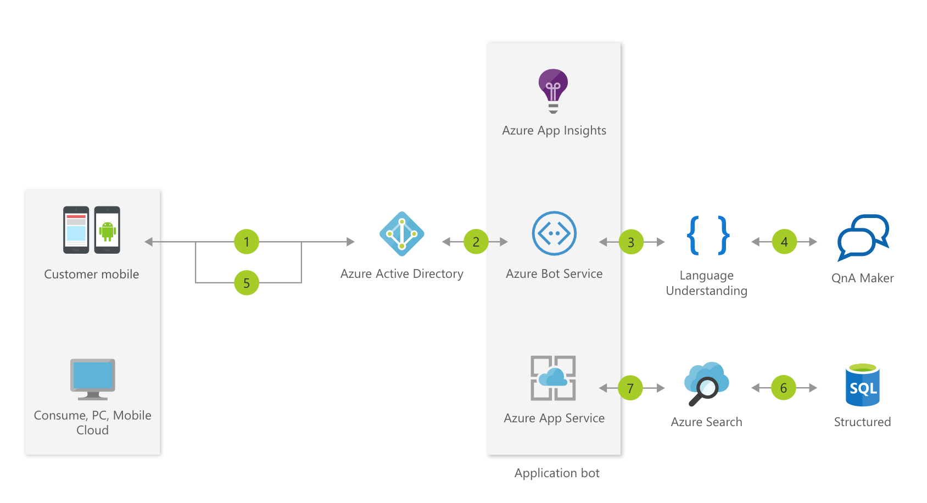
Information Chatbot

Slide 5
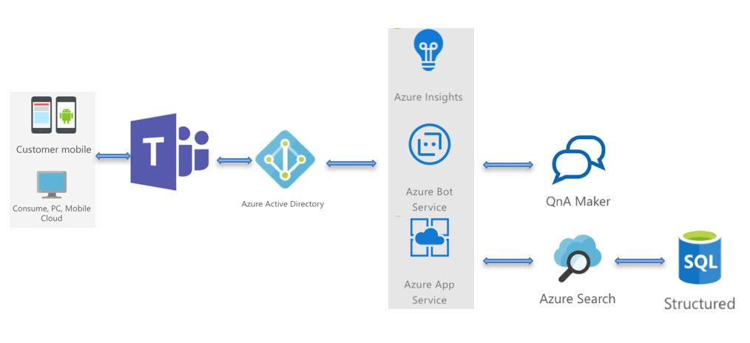
Information Chatbot
Chatbot
Purpose – Integrate – Collobarate - Retrieve Information Faster

Slide 6

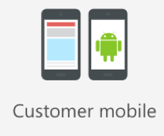


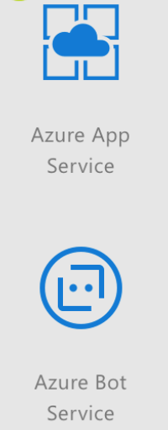

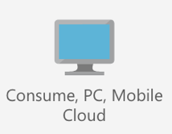



Information Chatbot

Slide 7
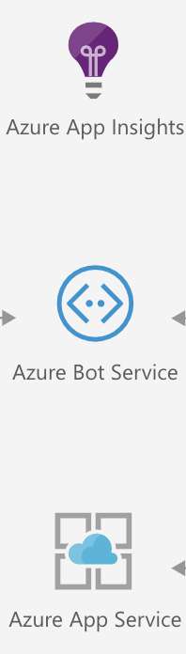
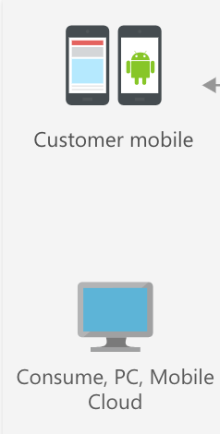

One Platform for all Applications
Knowledge Base

Slide 8



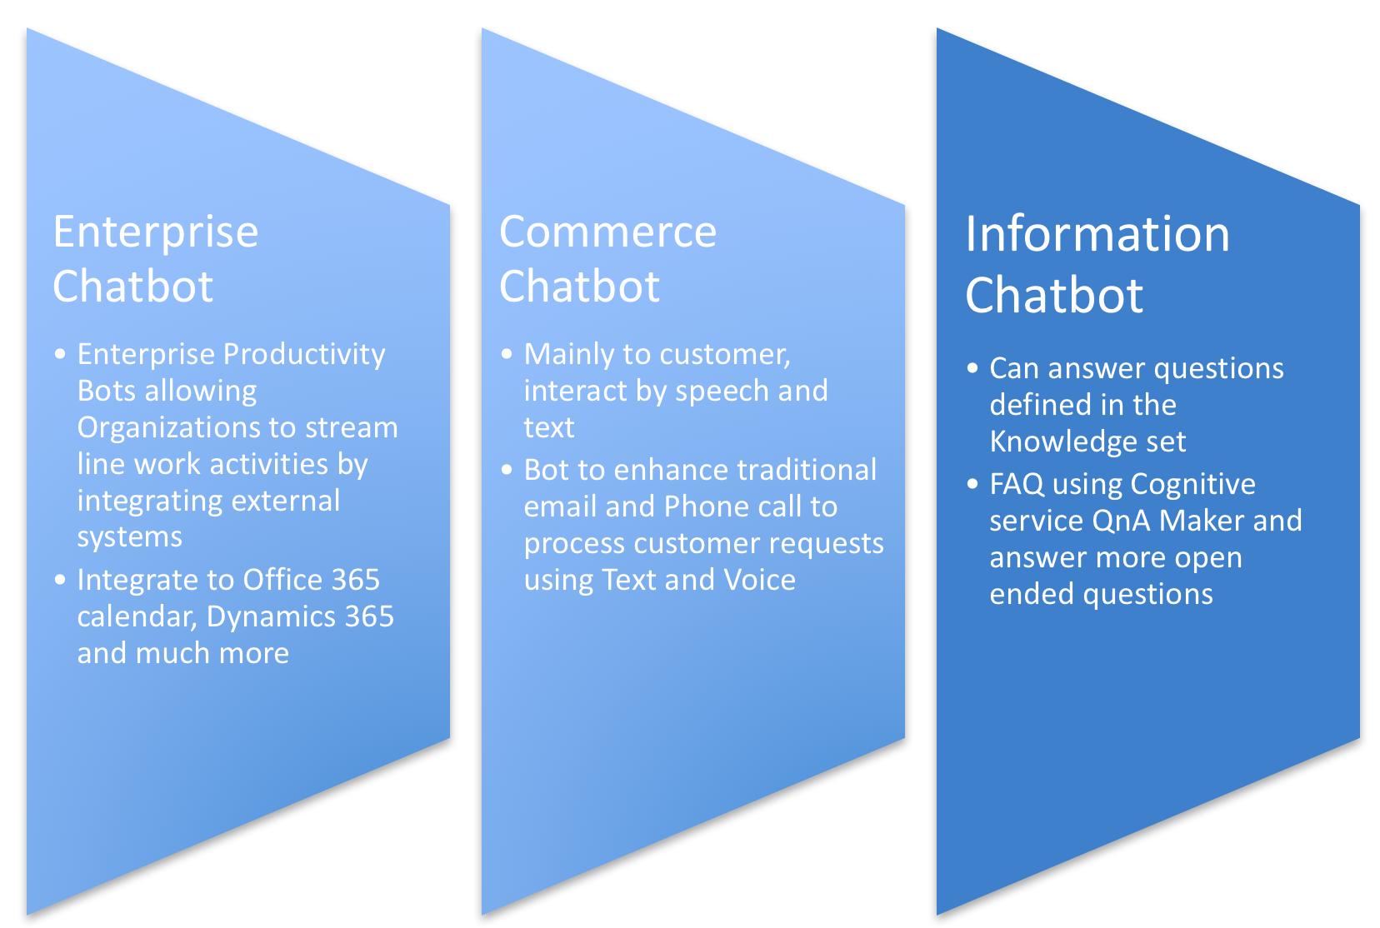
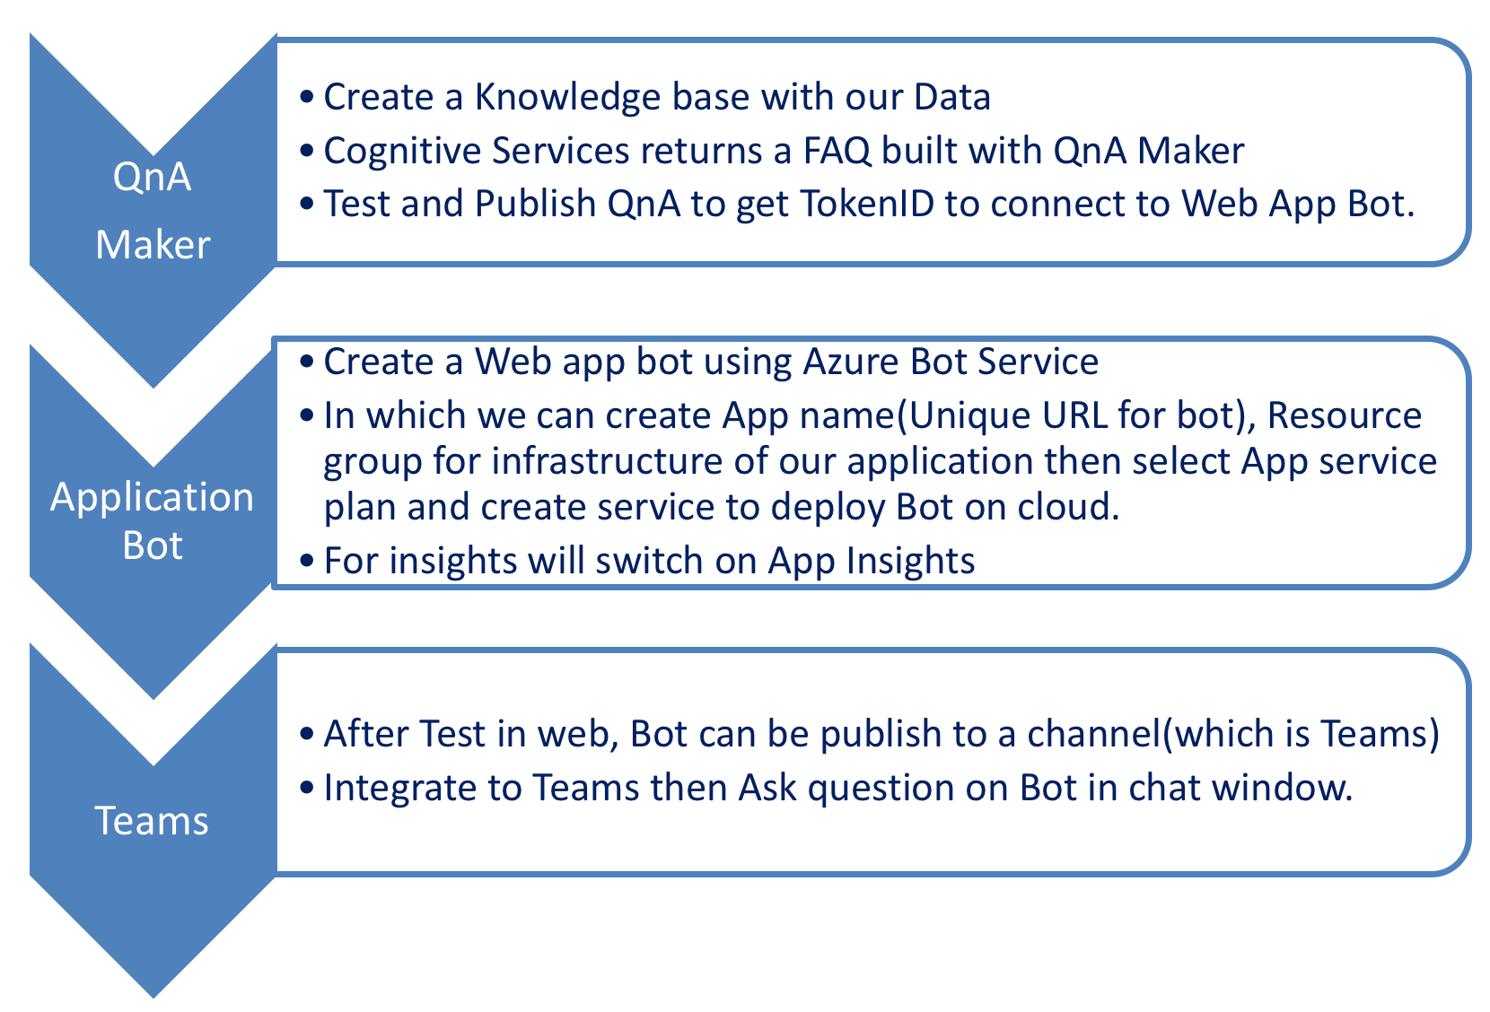
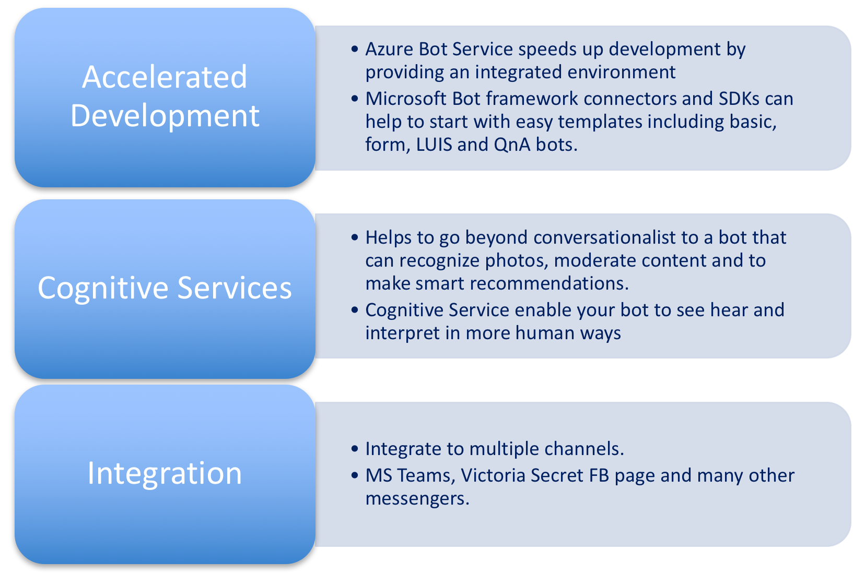
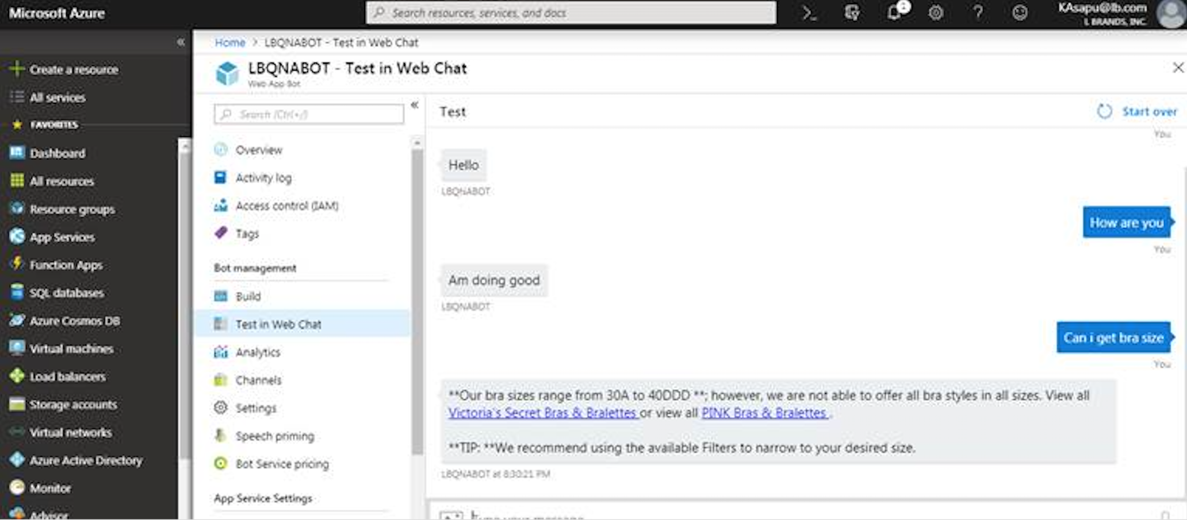
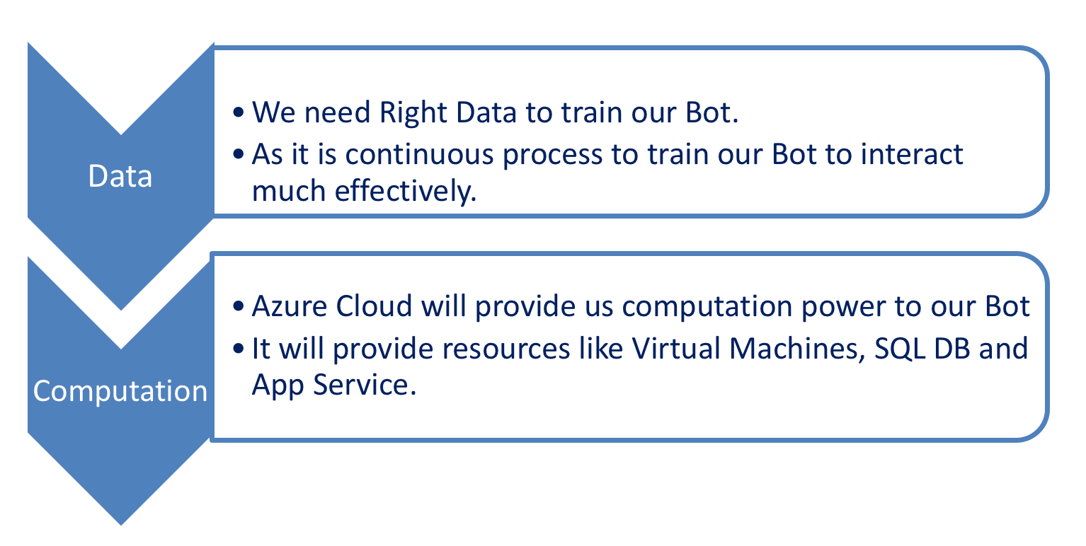
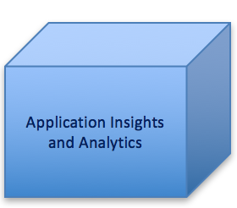
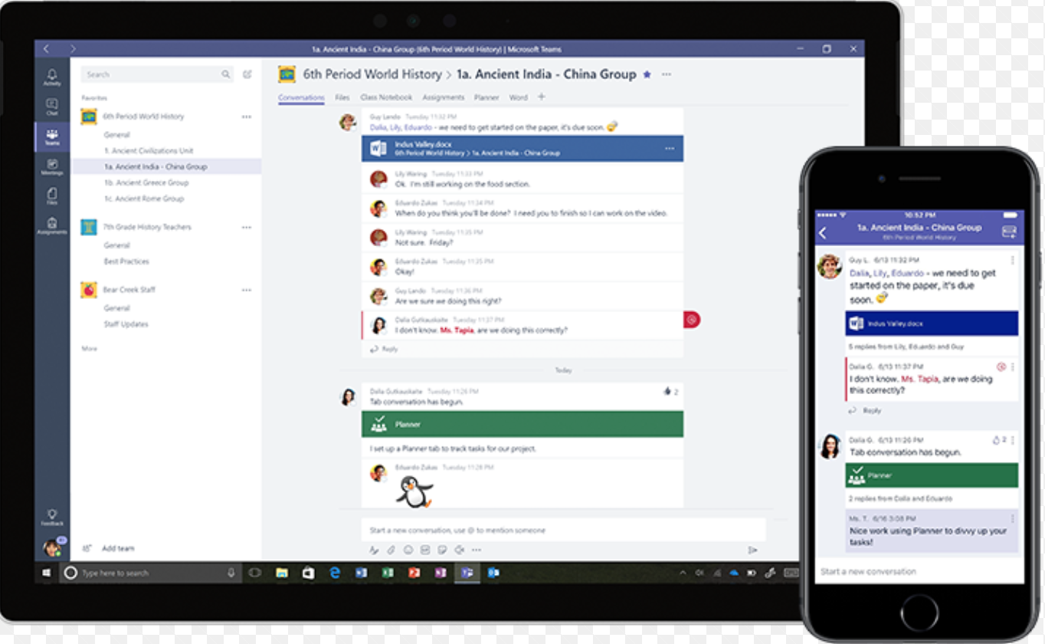

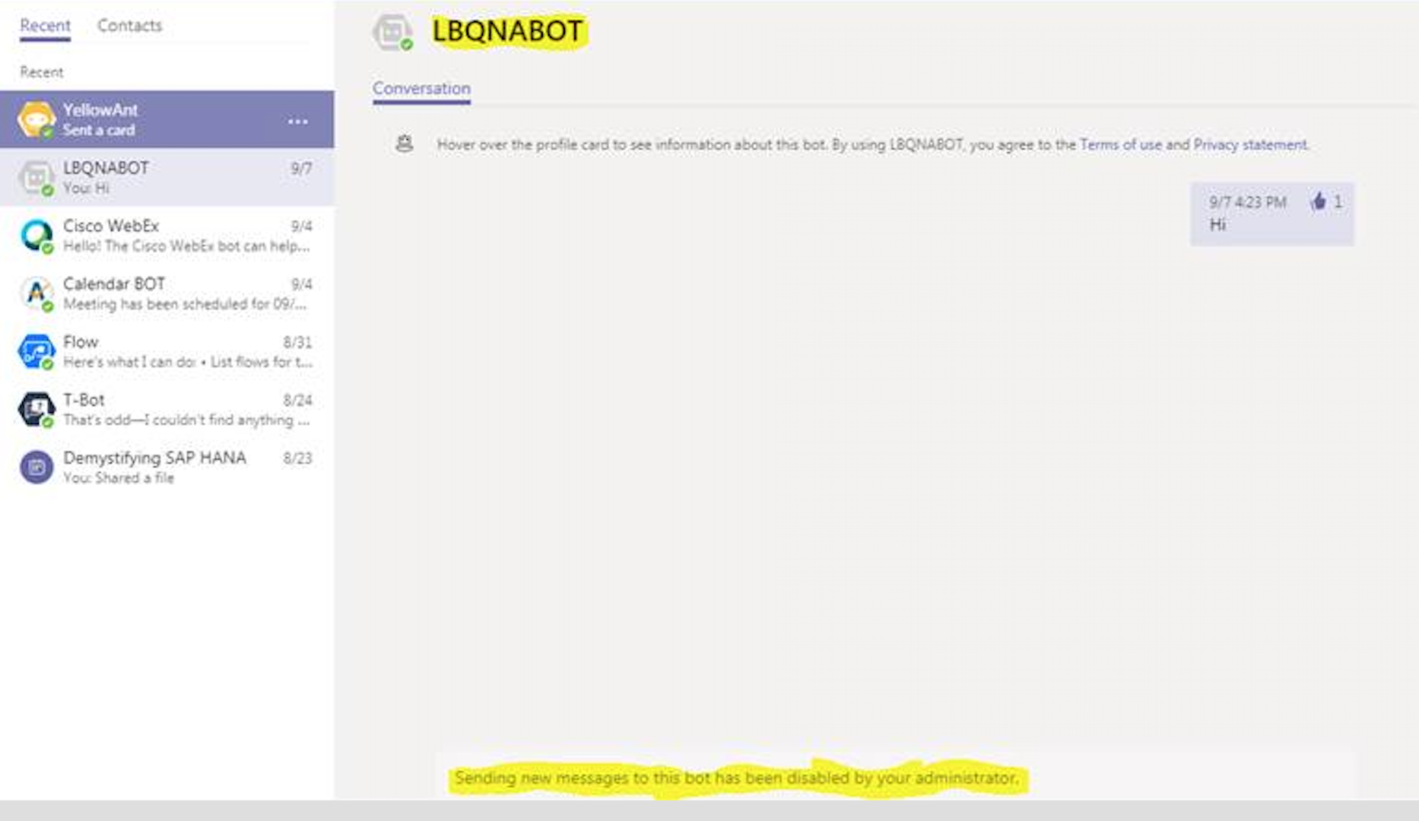
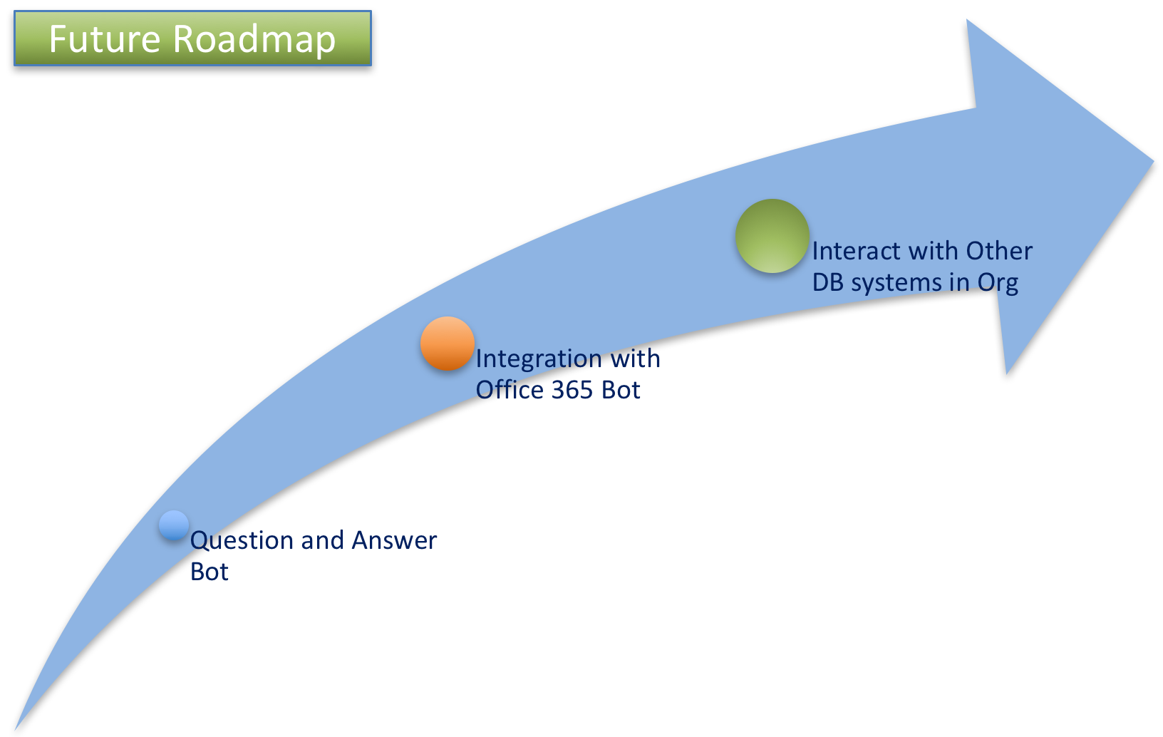
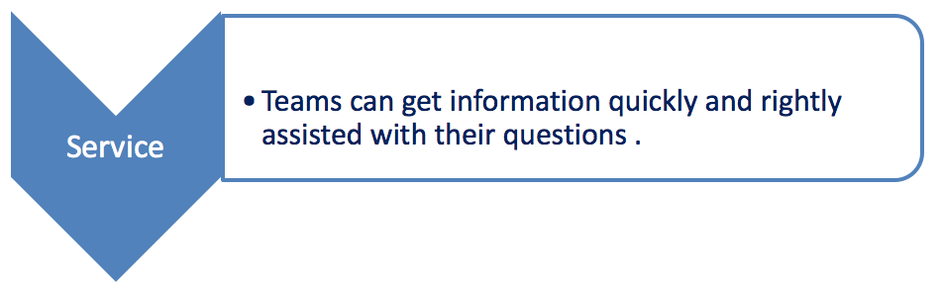
Process Flow
How it Built
Azure Cloud Bot Service
Test in Web Chat
What we need
Bot In Teams
Why we need

